Slide 1

Park Way Primary school
Mrs Trusler
EYFS Lead

Slide 2
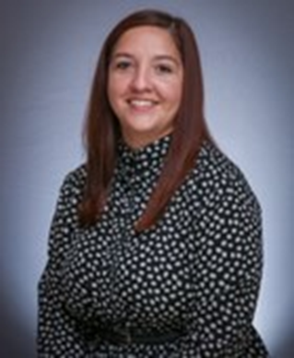
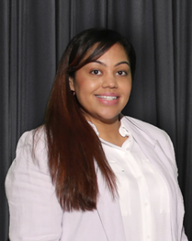
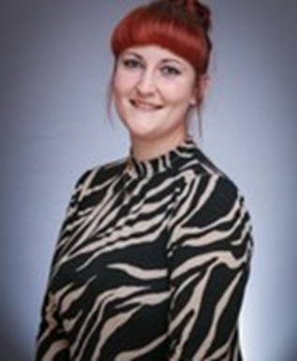
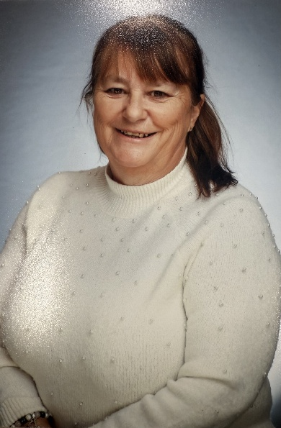
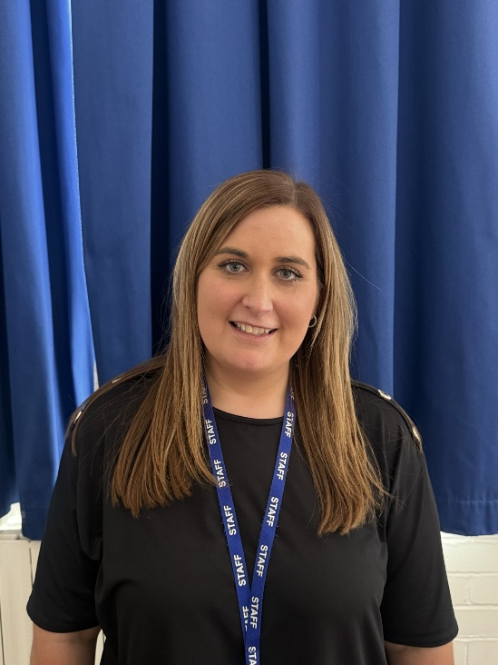
EYFS Team
Mrs Trusler
Apple Class Teacher
EYFS Lead
Mrs Green
Pear Class Teacher
Miss Mayley
Teaching Assistant
Mrs Healey
Teaching Assistant
Mrs Bramwell
Teaching Assistant

Slide 3
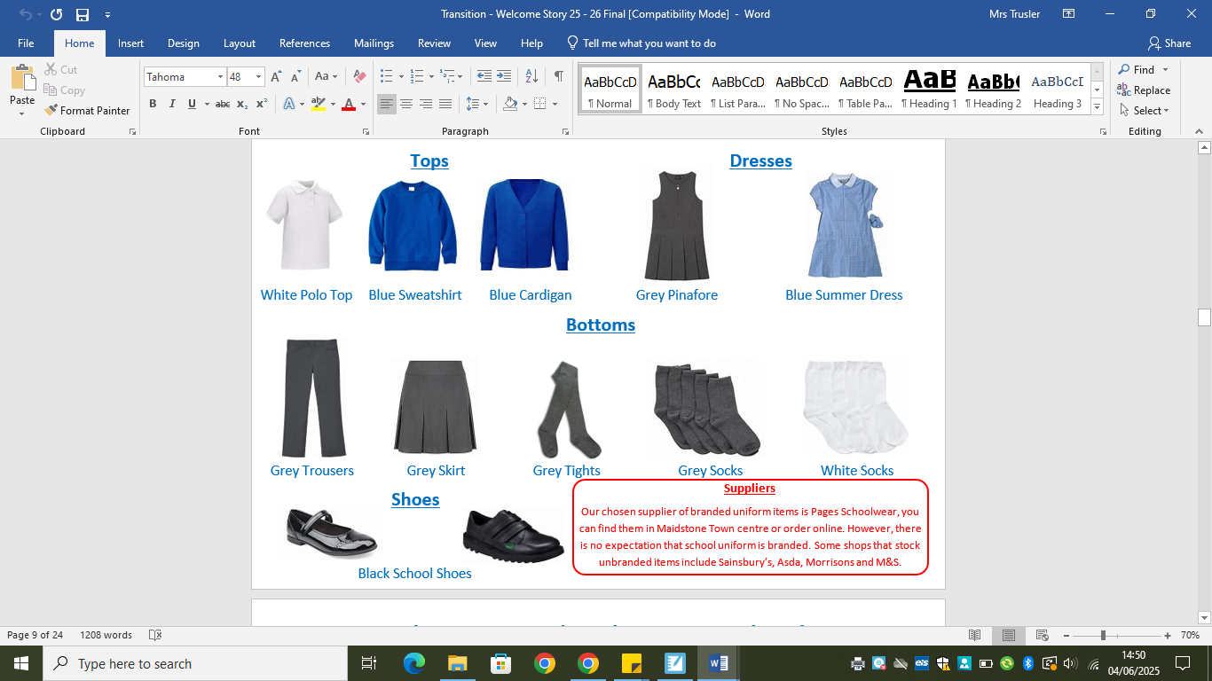
School uniform

Slide 4
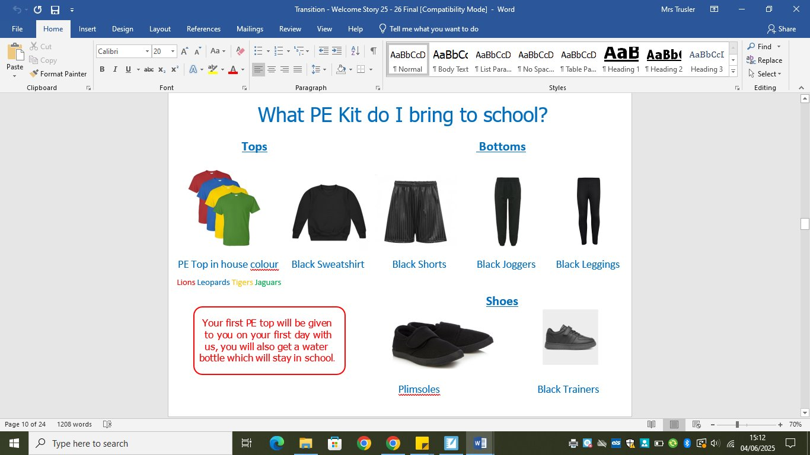
School uniform

Slide 5
School uniform
Shoes – consider VELCRO fastening, until your child can do their own laces.
Appropriate clothing – the children will go out in all weathers.
A pair of named wellies children can leave at school.
Warm coat, hat, gloves in the winter.
Sunhat, suncream in the summer.
Two-piece wet suit to be kept at school.
As part of the curriculum the children are encouraged to take part in a variety of messy activities.
Please leave some spare clothes / underwear in your child's book bag.
Please make sure EVERYTHING is named!

Slide 6


Slide 7
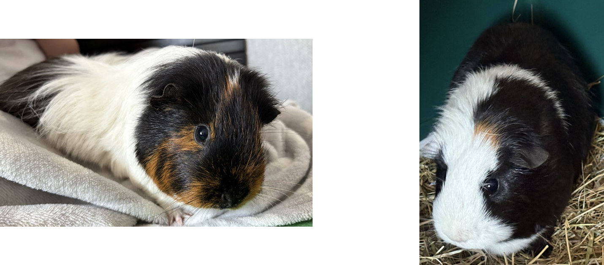
Stitch and Noodles
We are very lucky to have two Guinea pigs in Reception class. They are around a year old and love being stroked.
They live in Apple and Pear class so the children will see them daily.
In the summer months they come outside into our outside area and the children will have the opportunity to be a pet monitor and look after them by doing daily jobs such as feeding them.

Slide 8
Forms – Consent, emergency contacts, information – Allergies, vegetarian, consent for photos.
Home – school agreement
Policies – ICT acceptable use, attendance, behaviour, EYFS
Tapestry permission
Transition book – classroom, uniform, lunches
Pupil premium
Guinea pig consent
Packs

Slide 9
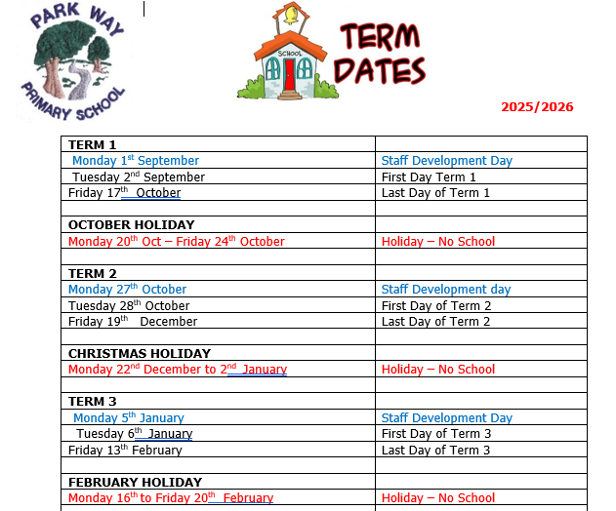
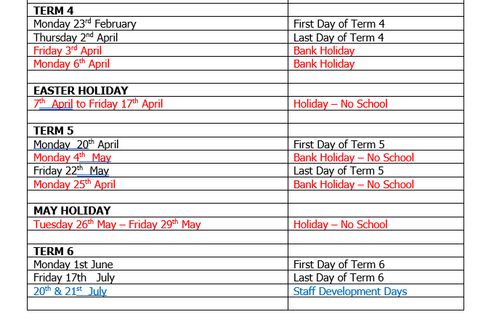

Slide 10
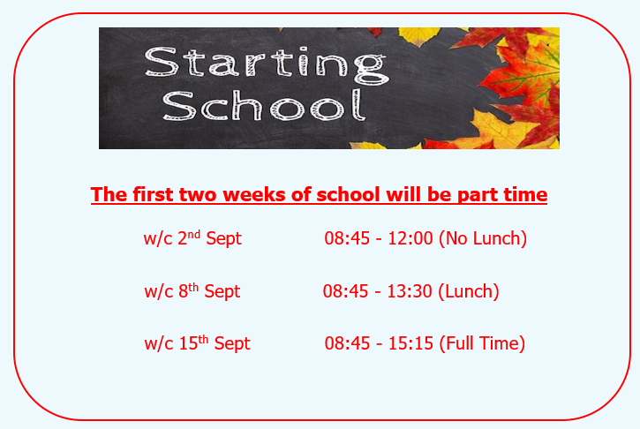
Doors open 8:45am
Doors close 8:55am End of the day 3:15pm

Slide 11

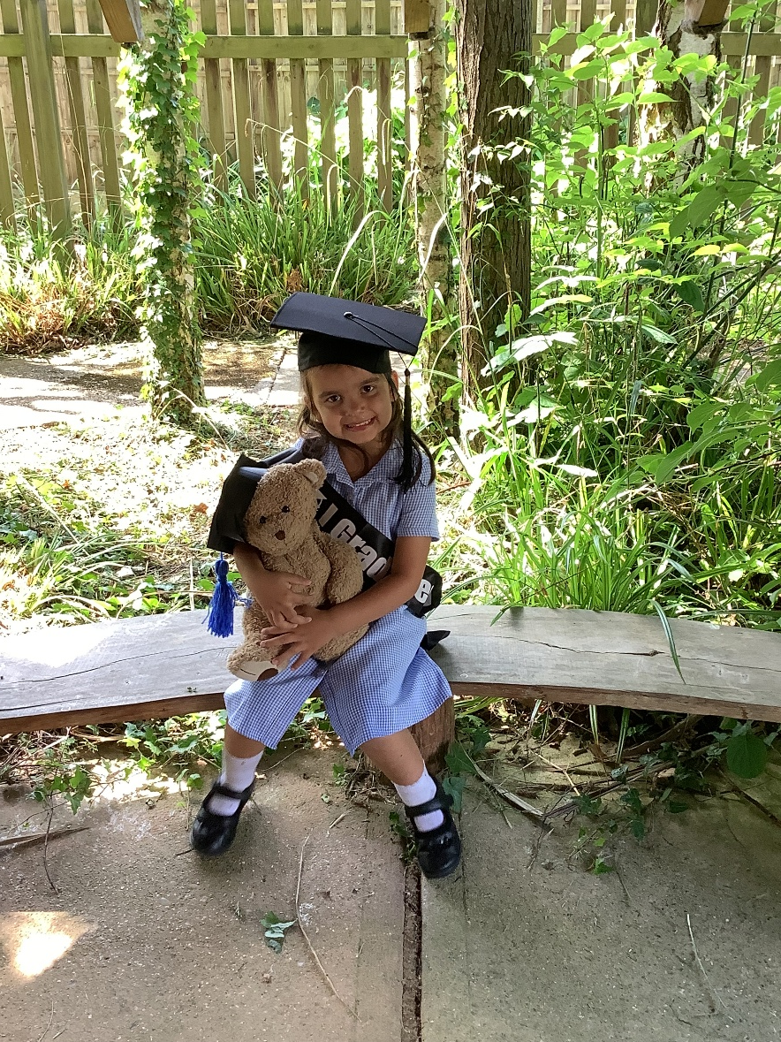
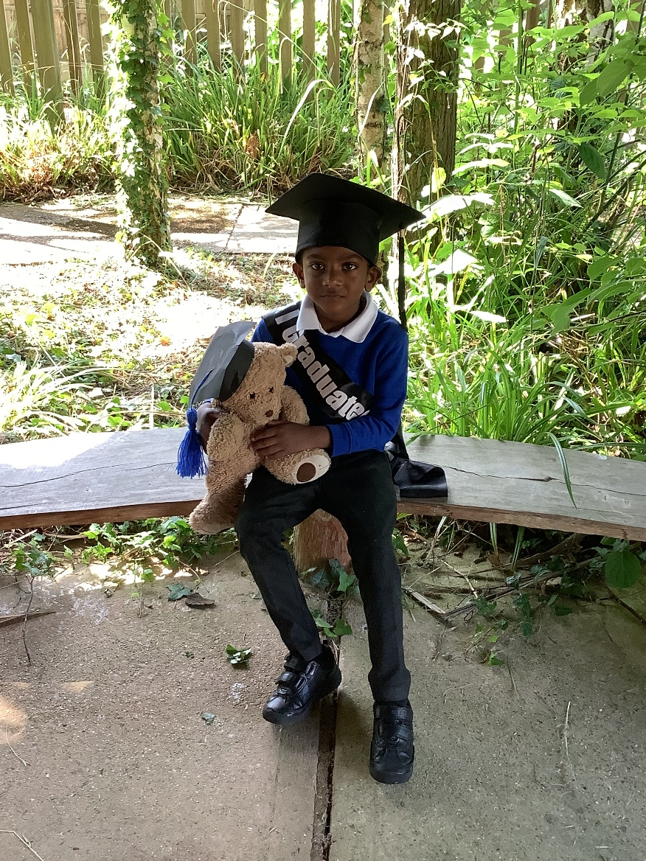
Early years at Park Way

Slide 12
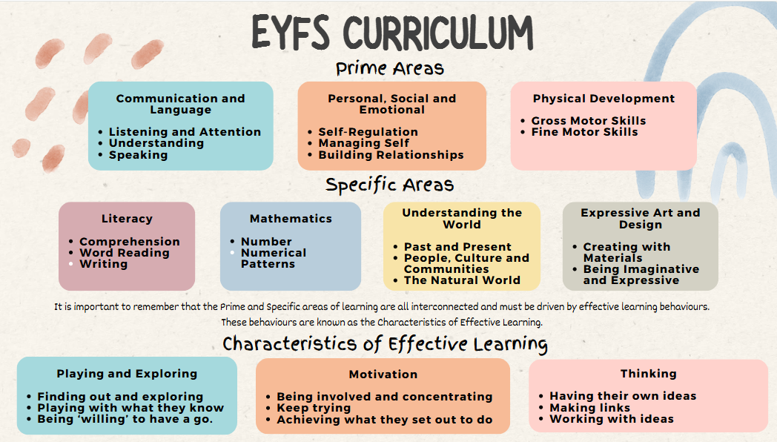

Slide 13
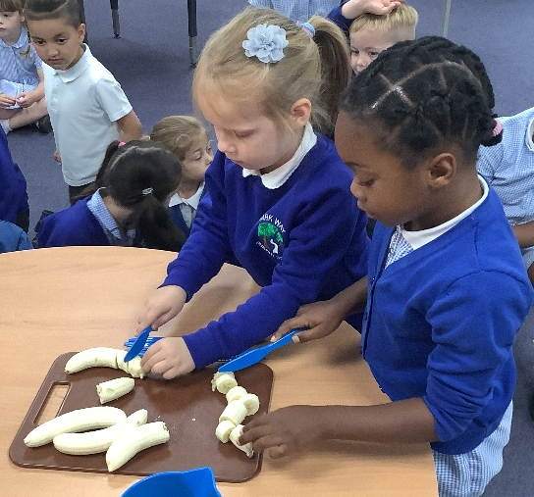
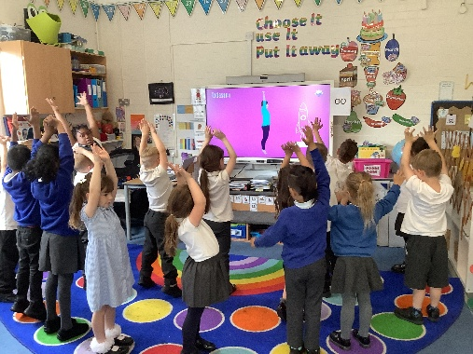
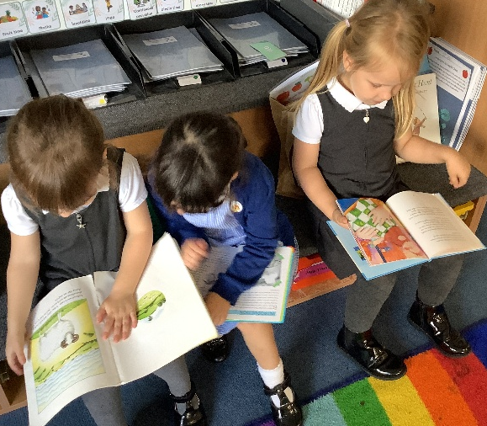
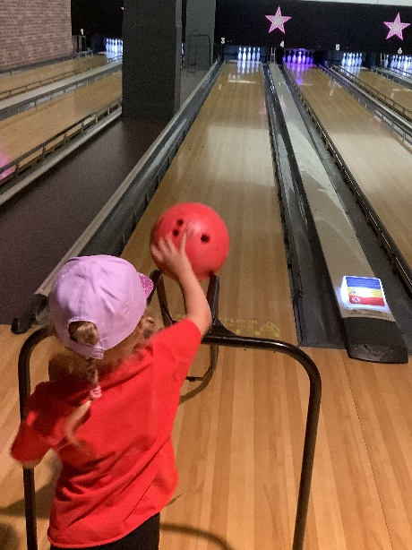
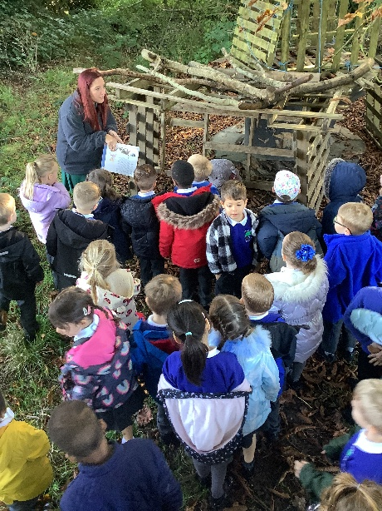
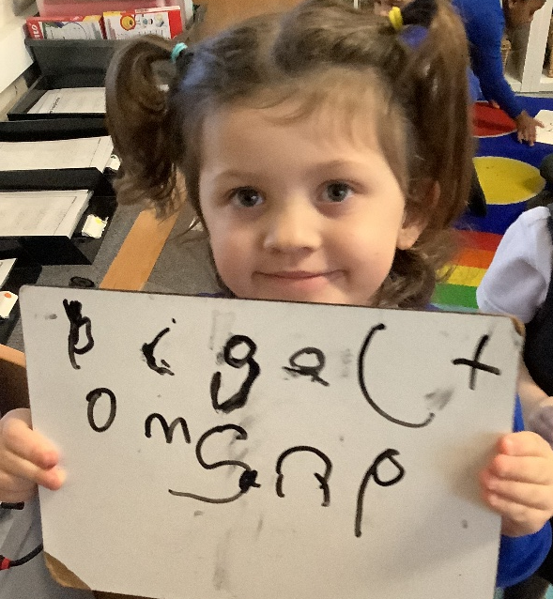
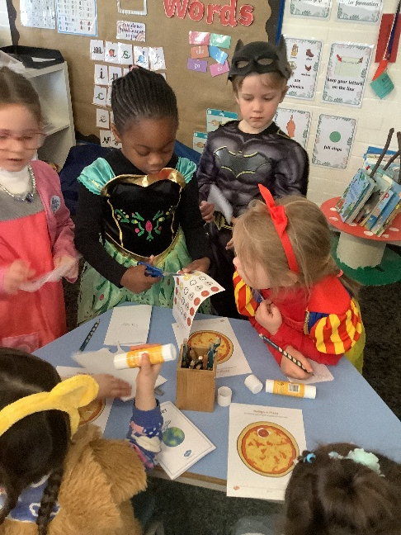
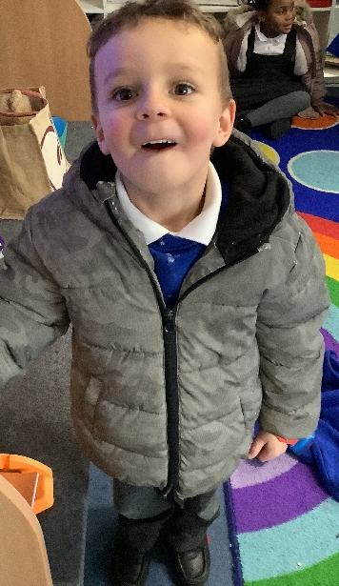
What do we do?
We provide a safe, enriching and stimulating environment to enable children to reach their full potential.
Children will be offered exciting opportunities; encouraging them to challenge themselves, try new things and ‘have a go’.
We will teach children to be independent and acquire the skills that enable them to learn and develop.
We want our children to enjoy achieving, have their own ideas and choose the way they want to do things!
Notes:
Brain breaks – dances, games
Cooking, baking – Cutting skills of fruit to make smoothies
Bowling – end of summer sport paid by the school
Writing letters and mark making
World book day – countries around the world – Italy, pizza cutting skills, Peru Paddington bear – instructions making maralade sandwiches
Teaching Zips and buttons
Love for reading
Going on a bear hunt – role-play the story on the field, found a big cuddly bear!

Slide 14
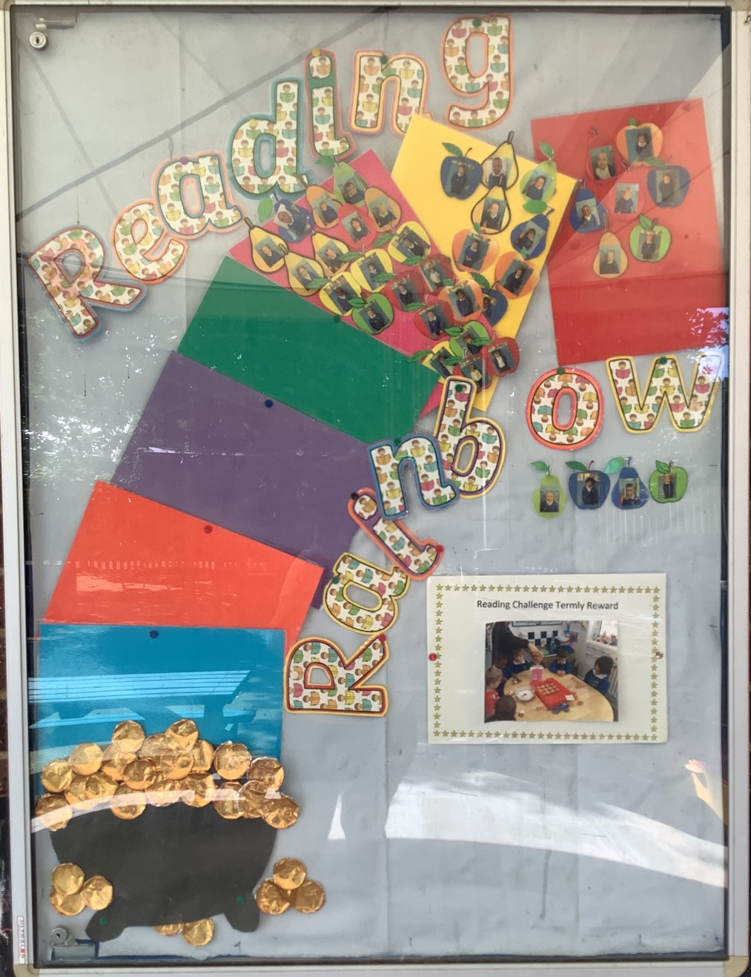
Reading challenge
We have a rainbow reading challenge to support our parents' involvement in helping our children to succeed with their phonics and reading.
The children will all have their photo on an apple or a pear depending on which class they are in.
Each week they read at home (at least once), they will move onto each colour of the rainbow.
If they read every week, they will move along the rainbow and reach the pot of gold.
They will receive our reading challenge treat for the term.
Every big term (Christmas, Easter and summer) they will also receive a reading badge. At the end of year, if read all year, they will receive a reading medal!

Slide 15

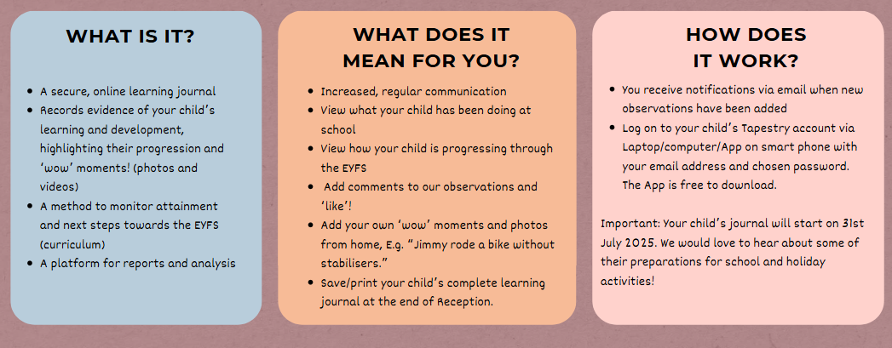
How will my child's learning be recorded?

Slide 16



A typical day in reception
8:45am: Self- registration, Early morning learning - funky fingers, welcome
9:00am: Wake up, shake up or daily mile
9:10am – Assembly
9:30am – Dough disco, Phonics
10:00am – Literacy, teacher directed
10:20am – Continuous provision, challenge time
11:00am – Snack & milk time
11:15am – Maths, teacher directed & continuous provision
11:50am – Lunch & playtime
12:55pm – Register
and quiet time
1:10pm – Teach directed time (RE, UTW, PHSE)
1:30pm – Continuous provision
2:45pm – Review time
2:55pm – Story
3:15PM – Home time
Dough Disco involves moulding play dough in time to music and performing different actions.
Notes:
This activity not only helps to strengthen children’s fine motor skills to enable them to develop their pencil grip which in turn will help develop their writing skills, but it also strengthens gross motor skills, get’s children moving, and most of all, it’s fun!
During ‘Challenge Time’ we get to choose what we would like to play with and afterwards we review our learning, sometimes by using photographs we took on Tapestry! We call it ‘Challenge Time’ because we get to try new things, challenge ourselves, and make links in our learning! Our teachers create challenges according to different areas of the curriculum, which are usually book related, to make learning engaging and purposeful! We get to show you what we’ve been up to on Tapestry too!

Slide 17
Expectations
Bookbag and water bottle daily
Read weekly with your child (more or daily when possible)
Support with phonics sounds keyring
Recognising numbers keyring
PE kit to be kept in school and returned first day of term
No earrings to be worn on PE days
School uniform to be worn with school shoes
Wellies, wet suit, coat, hats for appropriate weather at school

Slide 18
How you can support?
Share Transition booklets
Add summer events to Tapestry for us to share in September
Encourage your child to be independent
Socks and shoes
Getting dressed
Going to the toilet and wiping themselves
Recognising their own clothes, bag, bottle etc.
EYFS classroom open afternoon
(Termly on school Diary dates)
Class assemblies
Engage with Tapestry and support next steps
Parent meetings

Slide 19
